Slide 1



Theme 1: Warehouse Robot
THE NEST HACKATHON
ENPC TEAM

Slide 2

Introduction
Meet the next generation of warehouse automation. Our robot combines cutting-edge navigation with precision mechanics. It is designed to maximize efficiency and minimize operational costs.

Slide 3
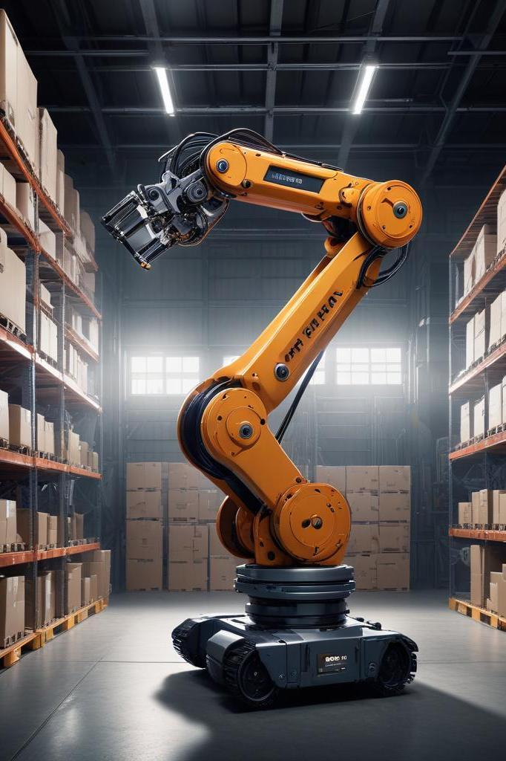
01
Robot Overview

Slide 4
Solution Overview
Smart Warehouse Robot Features:
Dijkstra-Powered Navigation for shortest-path routing.
Scissor Lift Mechanism for vertical package handling.
Servo Motor Precision for unpacking.
Centralized Web Dashboard for live tracking.

Slide 5

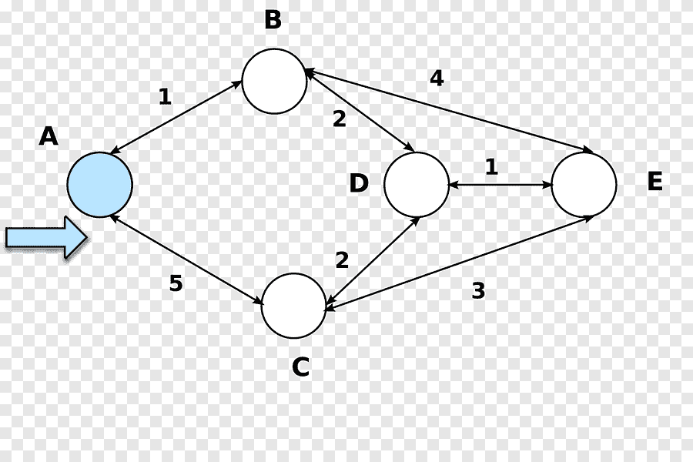
Navigation – Dijkstra's Algorithm
How It Works:
Maps warehouse as a graph with nodes/edges.
Computes shortest path to target, avoiding obstacles.
Benefits:
30% faster route optimization.
Adaptable to layout changes.

Slide 6
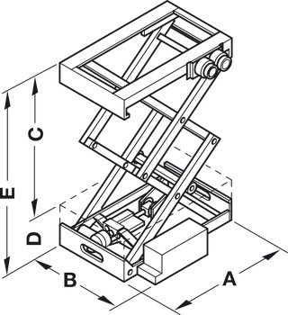
Lifting System – Scissor Mechanism
Function:
Expands vertically to reach high shelves.
Compact design for narrow aisles.
Benefits:
Lifts up to 50 kg.
Adjustable height (0.5m to 3m).

Slide 7

Centralized Command & Tracking Website
Features:
Real-Time Tracking:
RFID-driven package location/destination.
Robot status (moving, unloading).
Remote Robot Control:
Send direct commands (e.g., reroute, pause, change place).
Analytics & Alerts:
Traffic heatmaps, battery levels, error logs.

Slide 8

Use Case Walkthrough
Package arrives → RFID scanned → website assigns task to robot.
Operator prioritizes task via dashboard → robot recalculates path using Dijkstra.
Scissor lift retrieves package; servo unpacks.
Operator monitors progress and intervenes if needed (e.g., reroute).
Website updates status post-delivery.

Slide 9

Benefits Summary
Centralized Control: Command multiple robots from one dashboard.
Agility: Instantly adapt to urgent requests or disruptions.
Transparency: Audit trails for commands and actions.

Slide 10

Technical Specifications
Website Backend:
REST API for serialize data
Admin Dashboard for supervision
Dashboard for authenticated users
Robot Connectivity:
HTTP/WebSocket for real-time commands.

Slide 11
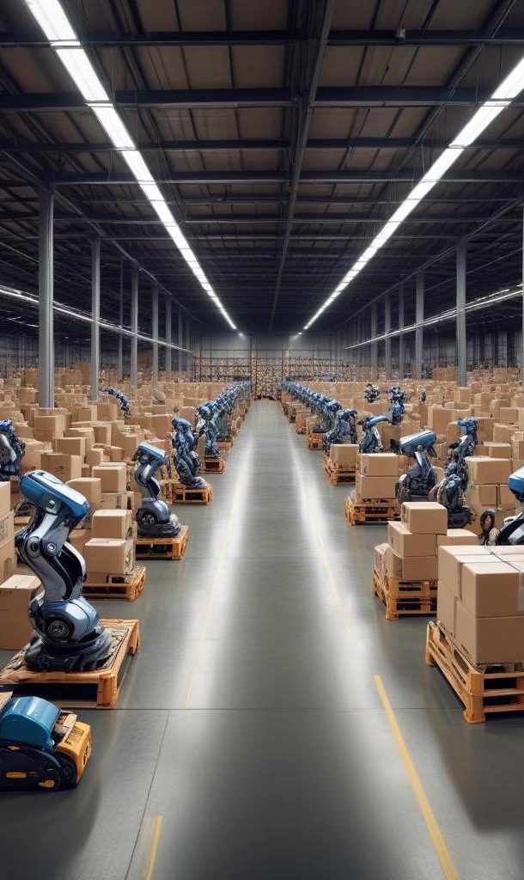
Conclusions
In summary, the warehouse robot represents a significant advancement in automated logistics. Through the utilization of sophisticated algorithms for navigation, efficient lifting mechanisms, and robust tracking systems, it enhances operational efficiency and accuracy within warehouse environments.

Slide 12

Thank you!
Do you have any questions?
+91 620 421 838

